Slide 1

NLP Based Resume Analysis and Ranking System
Aabha Bhide – 22106093 Aditi Gadhave – 22106079 Niharika Bandekar - 22106136
Sumeet Gupta – 22106071
Project Guide
Prof. Vijaya Bharathi Jagan

Slide 2
Outline
Introduction
Literature Survey of the existing system
Limitations of Existing Systems
Problem Statement
System Design
Technologies and methodologies
Implementation
SDG Goal Alignment
Future Work
References:

Slide 3
Introduction
A smart AI-driven recruitment system built using Machine Learning (ML) and Natural Language Processing (NLP).
Helps students/job seekers analyze, improve, and rank their resumes against job descriptions.
Enables HR professionals to efficiently screen, analyze, and rank candidates based on resume data.
Provides ATS scoring, skill-gap analysis, strengths, weaknesses, and improvement tips.
Supports job browsing, targeted resume analysis, mock interviews for students.
HRs can create job postings, bulk upload resumes, and view ranked candidate reports with detailed reasoning.

Slide 4
Motivation:
Manual resume screening is time-consuming, biased, and error-prone.
Recruiters struggle to analyze large volumes of applications quickly.
Students often have unoptimized resumes that fail to meet ATS standards.
There’s a need for an automated system that evaluates resumes objectively and intelligently

Slide 5
Objectives:
To build an NLP-based system that analyzes, ranks, and matches resumes with job descriptions.
To generate an ATS score, success rate, and feedback highlighting strengths and improvement areas.
To identify skill gaps and recommend suitable courses to bridge them.
To enable students to apply, track applications, and attend mock interviews through one platform.
To allow HRs to create jobs, upload resumes in bulk, and view ranked candidates with detailed reasoning.

Slide 6
Literature Survey of the existing system
Year | Title | Domain | Algorithm | Dataset | Gap
2024 | Machine Learning-Based HR Management Information Retrieval and Classification Algorithm | HR Data Retrieval & Classification | Information retrieval (IR) models, ML classifiers, ranking-based retrieval | HR document repository | Emphasizes document retrieval; does not perform ATS or candidate–job matching.
2023 | Automated Resume Parsing: A Natural Language Processing Approach | Resume Parsing, Information Extraction | spaCy NER, PyMuPDF for text extraction, Transformer models for entity recognition | Custom dataset of PDF/DOCX resumes | Focuses only on parsing structured info (skills, education, experience); lacks candidate ranking or ATS scoring.

Slide 7
Year | Title | Domain | Algorithm | Dataset | Gap
2023 | VacancySBERT: Representation of Titles and Skills for Semantic Similarity Search | Semantic Matching in Recruitment | Sentence-BERT (SBERT) for embeddings, cosine similarity for semantic search | Proprietary job–resume corpus | Addresses semantic similarity but does not integrate ranking or skill gap detection.
2023 | A Machine Learning Approach to Detecting Fraudulent Job Types | Resume Verification, Fraud Detection | Outlier detection, anomaly detection, AI-based consistency checks | Online job postings dataset | Detects fraud but not suitable for resume–job semantic analysis or scoring.
2023 | Enhancing Diversity and Reducing Bias in Recruitment through AI | Fairness & Ethical AI in HR | Explainable AI, bias detection, fairness-aware ML models | Literature-based study | Focuses on ethics and transparency but lacks technical implementation for resume analysis.

Slide 8
Limitations of Existing Systems
Manual resume screening is slow and inefficient for large applicant volumes.
Human bias affects fairness and consistency in candidate evaluation.
Traditional ATS tools focus only on keyword matching, ignoring context or relevance.
No feedback or improvement suggestions are provided to candidates.
Lack of personalized skill-gap analysis or career guidance for job seekers.
HRs often manually compare and rank candidates, leading to delays.

Slide 9
Introduce AI-powered NLP and ML models for intelligent resume understanding and ranking.
Implement semantic matching to analyze context, not just keywords.
Provide ATS scoring with detailed feedback, strengths, and improvement tips.
Add skill-gap detection and course recommendations for self-improvement.
Enable mock interviews for students.
Allow HRs to bulk upload resumes, get automated ranking with reasoning, and manage interviews easily.
Build a centralized platform where both students and HRs can track, analyze, and optimize hiring activities.
Our Improvement Plan:

Slide 10
Problem Statement
The recruitment process involves analyzing thousands of resumes manually, which is time-consuming and error-prone.
Traditional ATS systems rely mainly on keyword matching, missing the contextual understanding of resumes.
Students lack feedback on their resumes, skill gaps, and job readiness.
HR professionals face challenges in objectively ranking candidates and managing large-scale applications.
There is a need for an AI-based system that can analyze, score, and rank resumes intelligently while providing personalized insights to both students and recruiters.

Slide 11
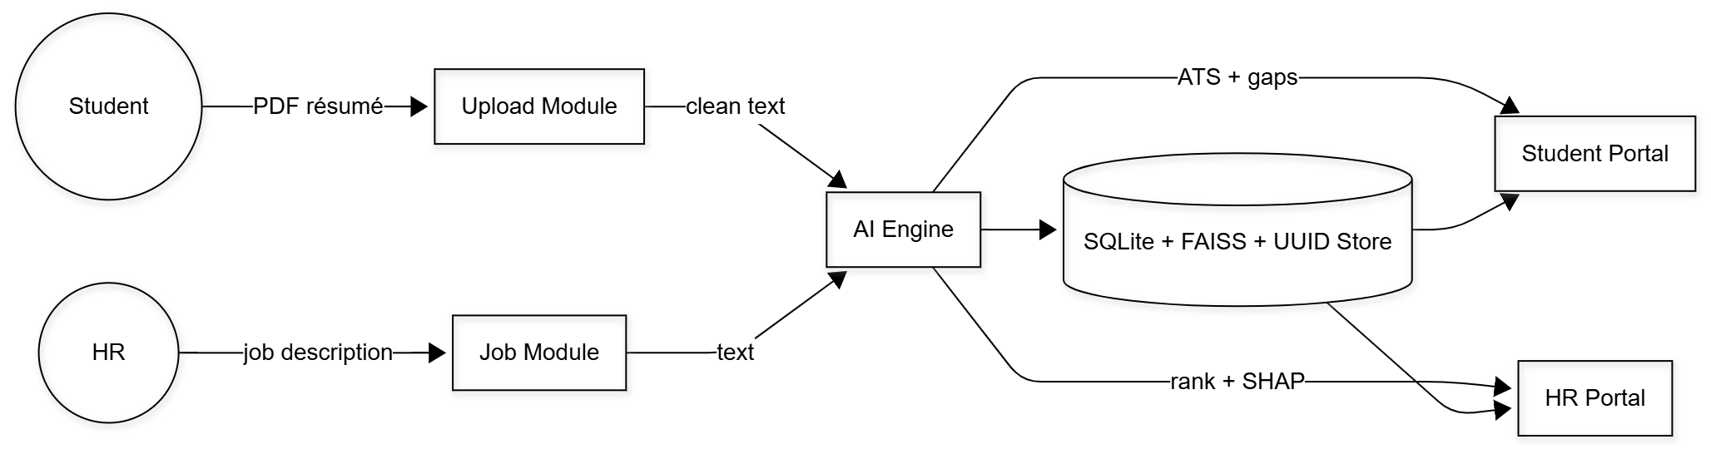
System Design
clean
Students upload resumes; HRs post job descriptions.
The AI Engine processes text using NLP and ML models.
Generates ATS scores, skill gaps, and candidate rankings.
Stores results in SQLite with FAISS indexing.
Outputs are displayed in Student and HR portals.

Slide 12
Students upload resumes; HRs submit job descriptions.
Text is preprocessed and analyzed using multiple AI models.
TF-IDF + Cosine checks keyword relevance.
MiniLM + FAISS measures semantic similarity.
BART-NLI performs skill-gap and entailment analysis.
JobBERT NER extracts skills, degrees, and experience.
LSTM Network predicts career progression.
All model outputs are combined using a Weighted Ensemble and ranked by RankNet.
SHAP provides interpretability for HR insights.
Final results (ATS scores, rankings, gaps) are stored in SQLite + FAISS and shown in Student and HR portals.

Slide 13
Technologies and methodologies
Backend
Python FastAPI – Main backend framework
REST APIs – For all router endpoints and data communication
JWT Authentication – Secure token-based authentication
SQLAlchemy ORM – Database interaction and schema management
Database & Storage
SQLite – Primary database for user, resume, and job data
FAISS Vector Store – For semantic similarity search and ranking
UUID File System – For unique and organized local file storage
Frontend
React – Web application frontend framework
Chakra UI – Responsive user interface design

Slide 14
Technologies and methodologies
Natural Language Processing (NLP)
TF-IDF + Cosine Similarity – Keyword matching and relevance scoring
MiniLM Sentence Embeddings – Semantic similarity between resume and job description
BART-NLI (Zero-shot Classifier) – Skill-gap and entailment analysis
JobBERT NER – Extraction of skills, degrees, and company entities
Machine Learning
RankNet (PyTorch) – Candidate ranking using deep learning
SHAP – Model interpretability and feature importance visualization
Weighted Ensemble Model – Combines multiple AI model outputs for final scoring

Slide 15
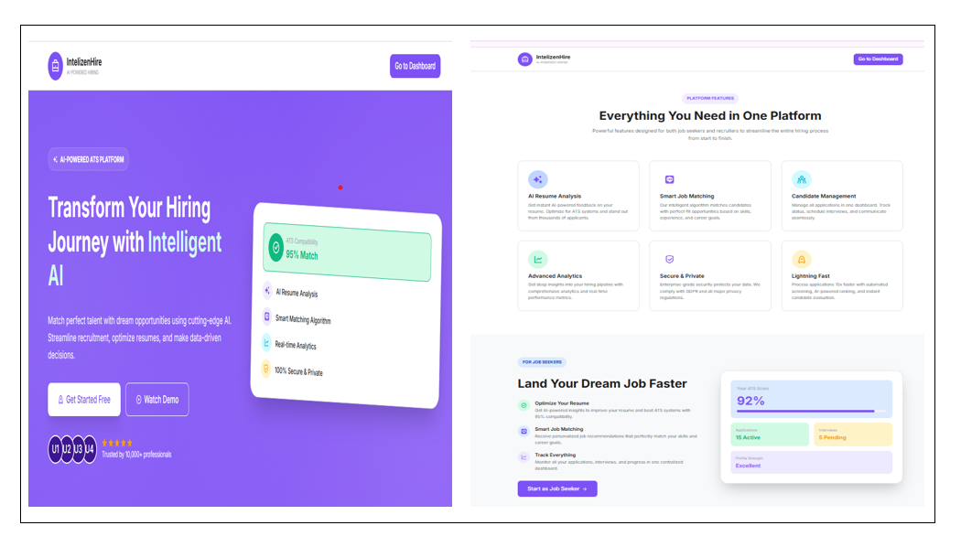
Implementation
Figure 1 Landing Page

Slide 16
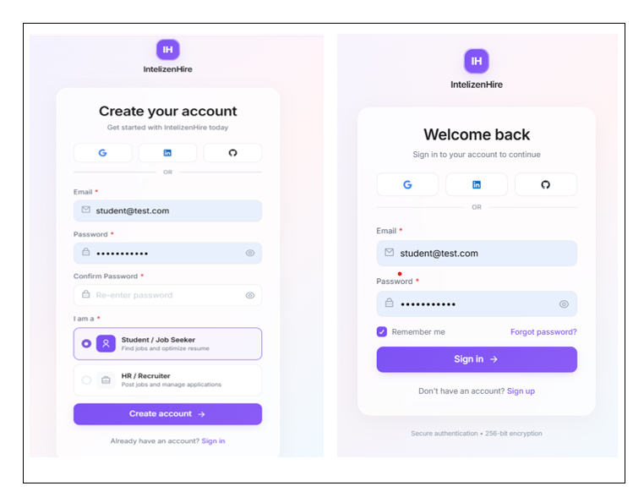
Figure 2: Register and Sign in Page

Slide 17
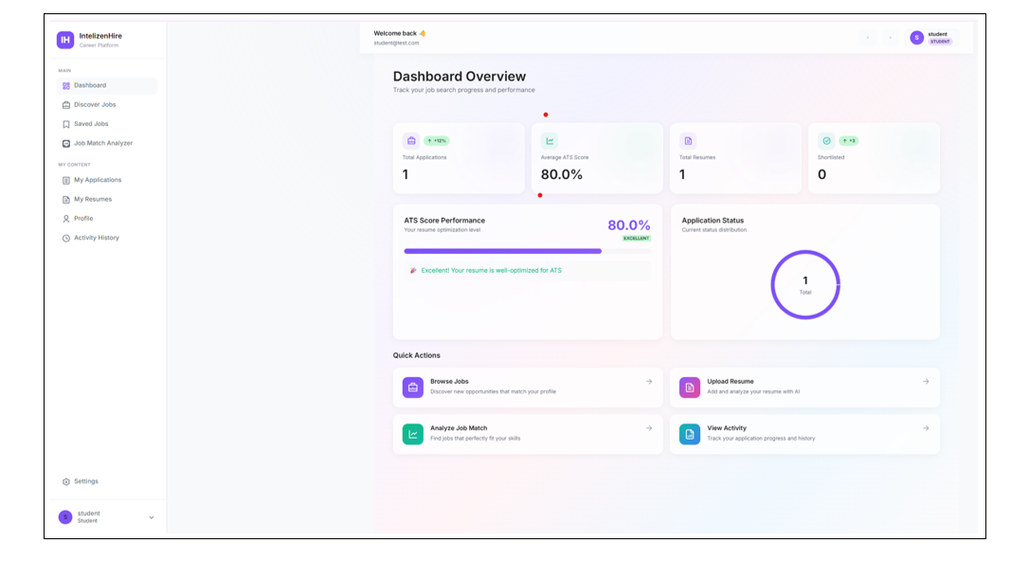
Figure 3 Student Dashboard

Slide 18
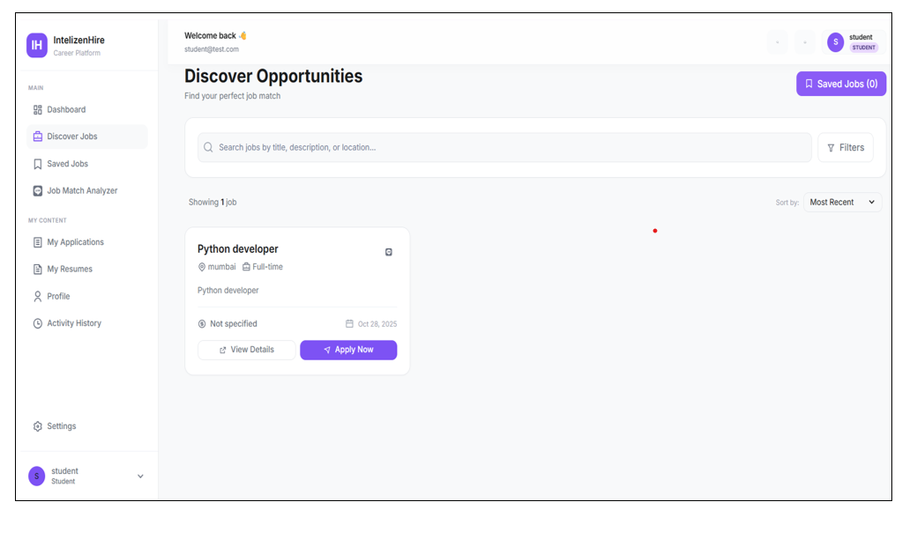
Figure 4: Student Job Browsing

Slide 19
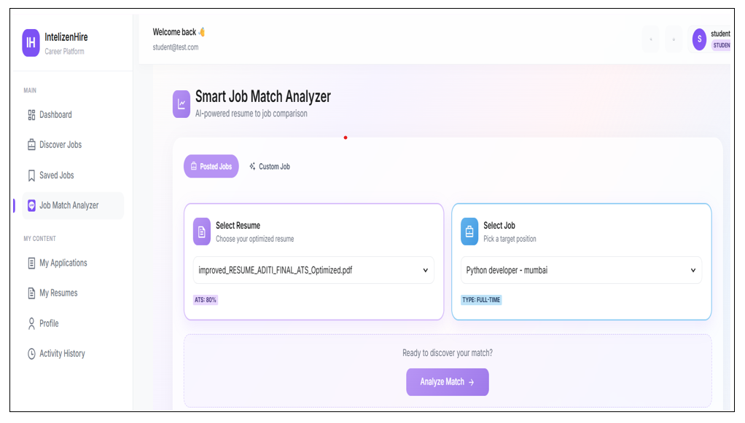
Figure 5: Student Resume & Job Matcher
Figure 5.9 Student Resume Analysis

Slide 20
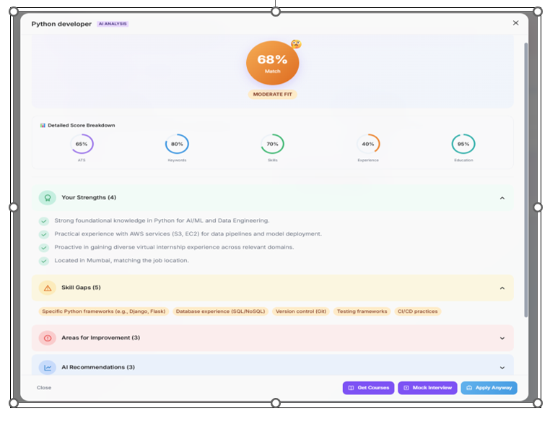
Figure 6: Student Resume Analysis

Slide 21
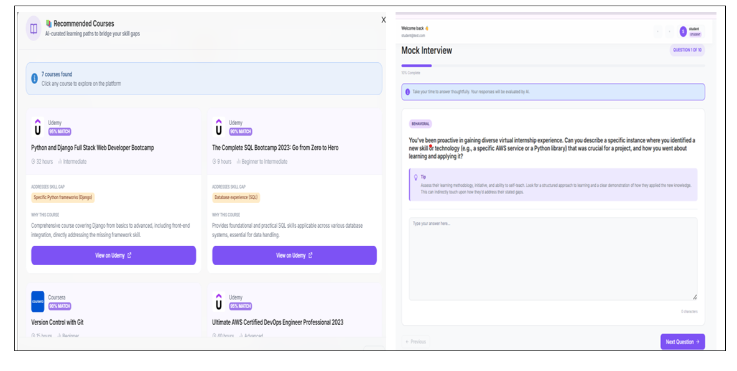
Figure 7 Student: Recommendation Courses & Mock Interviews

Slide 22
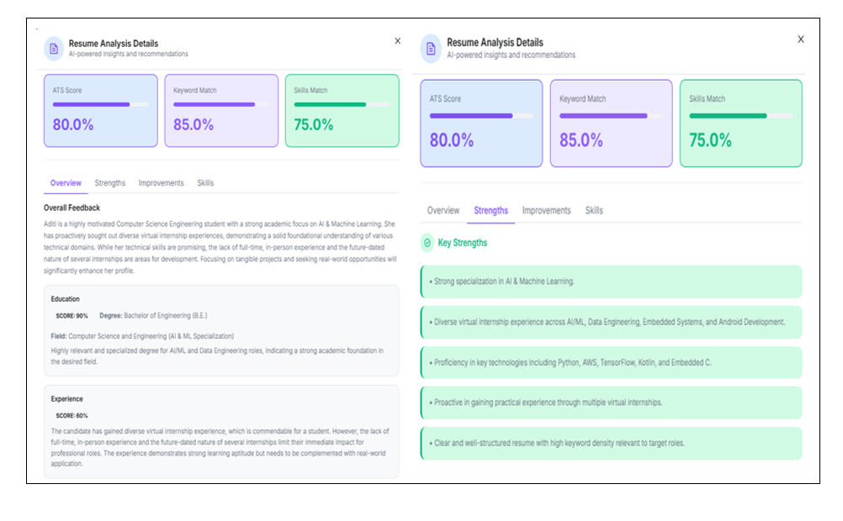
Figure 8: Student Resume Analysis (Overview & Strengths)

Slide 23
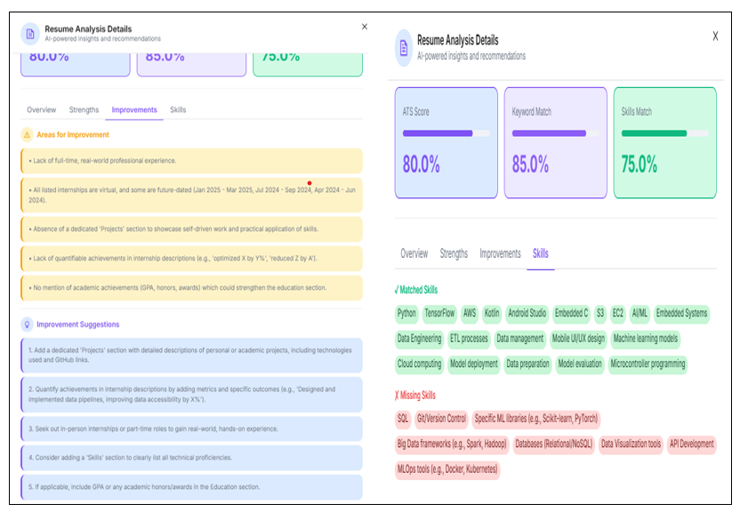
Figure 9: Student Resume Analysis (Improvements & Skills)

Slide 24
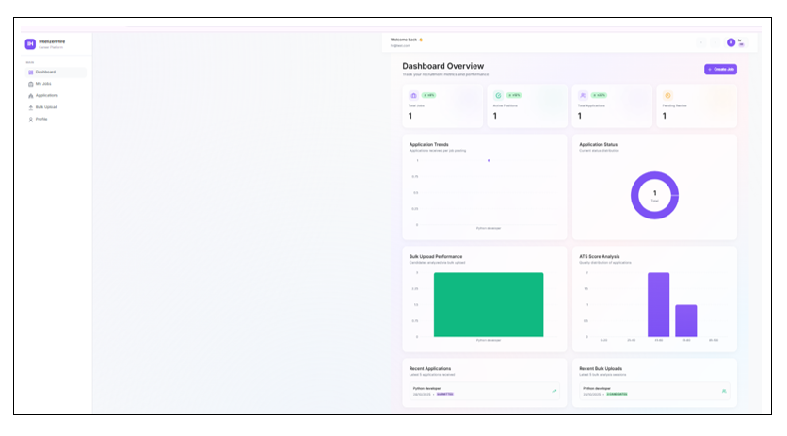
Figure 10: HR Dashboard

Slide 25
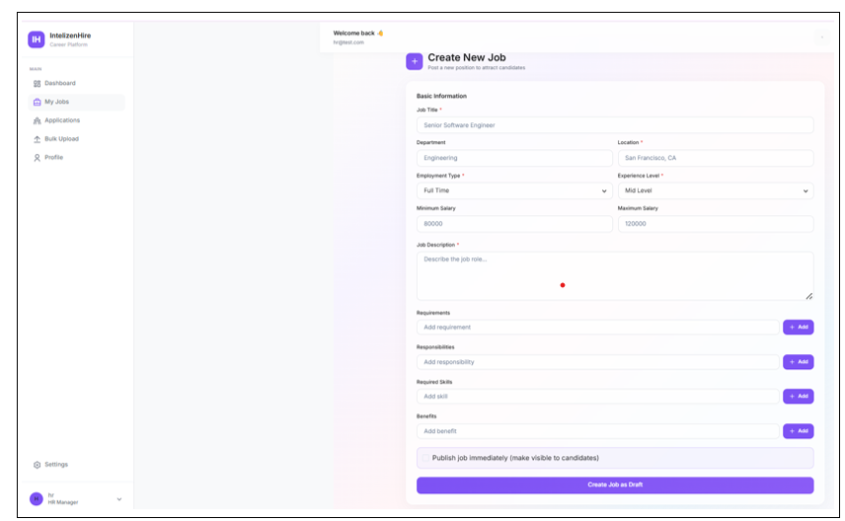
Figure 11: HR Job Posting

Slide 26
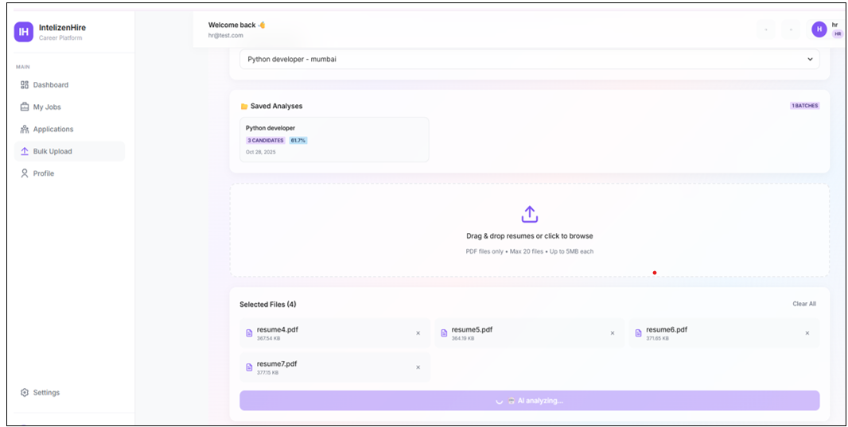
Figure 12: HR Bulk Resume Upload

Slide 27
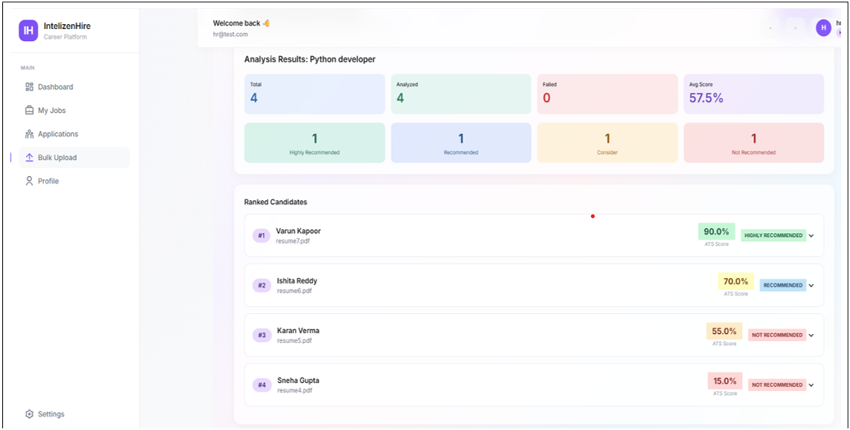
Figure 13: HR Candidate Ranking

Slide 28
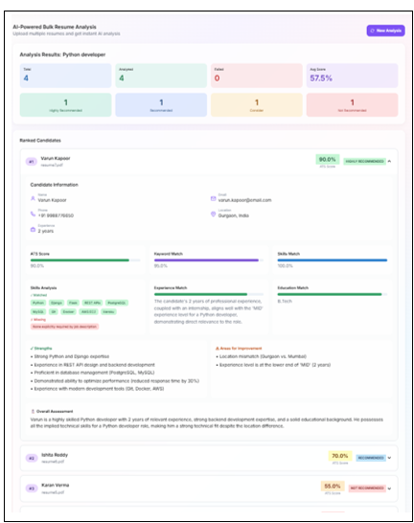
Figure 14: HR Candidate Ranking Analysis

Slide 29
SDG Goal Alignment
SDG 4: Quality Education – Promotes continuous learning by identifying skill gaps and recommending relevant courses for students.
SDG 8: Decent Work and Economic Growth – Enhances employability through resume optimization, mock interviews, and career guidance.
SDG 10: Reduced Inequalities – Ensures fair and unbiased candidate evaluation using AI-driven scoring and ranking.
SDG 17: Partnerships for the Goals – Bridges the gap between educational institutions, students, and recruiters through a unified digital platform.

Slide 30
References: [1] Wen Li and XiuKao Zhou, Machine Learning-Based HR Management Information Retrieval and Classification Algorithm, Scalable Computing: Practice and Experience, Vol. 25, No. 6, pp. 5431-5440, 2024.
[2] Sougandh, Thatavarthi Giri, Nithish Sagar Reddy, and Meena Belwal, Automated Resume Parsing: A Natural Language Processing Approach, In 2023 7th International Conference on Computation System and Information Technology for Sustainable Solutions (CSITSS), IEEE, pp. 1-6, 2023.
[3] Maiia Bocharova, Eugene Malakhov, and Vitaliy Mezhuyev, VacancySBERT: Representation of Titles and Skills for Semantic Similarity Search, arXiv preprint arXiv:2307.16638, 2023.
[4] Marcel Naudé, Kolawole John Adebayo, and Rohan Nanda, A Machine Learning Approach to Detecting Fraudulent Job Types, AI & Society, Vol. 38, No. 2, pp. 1013-1024, 2023.
[5] Ramakrishnan Vivek, Enhancing Diversity and Reducing Bias in Recruitment through AI, Informatics. Economics. Management, Vol. 2, No. 4, pp. 0101-0118, 2023.

Slide 31
THANK YOU

